Slide 1
Inclined Planes

Slide 2
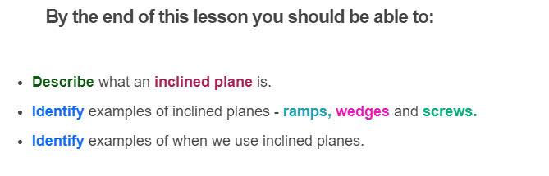


Slide 3
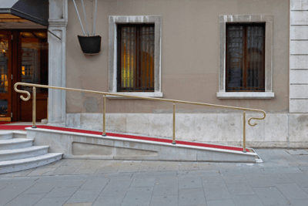
An inclined plane makes it easier for us to lift things upwards.
An inclined plane is a ramp. A ramp makes it easier to raise or lower a heavy object.
For example, it's much easier to push someone in a wheel chair up a ramp, than to lift them upwards onto the next floor.

Slide 4

Using a ramp means moving a greater distance.
Although ramps allow us to apply less force for moving things up or down, we have to travel a greater distance to do so.

Slide 5
Inclined planes are a simple machines that allows us to save effort by giving us a mechanical advantage.

Slide 6
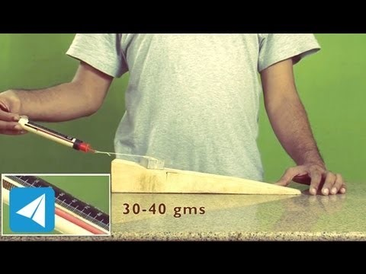

Slide 7


Slide 8
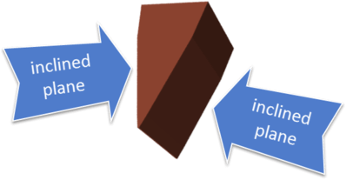
So far we have looked at ramps, which only have one inclined plane in their structure. But what about other simple machines that use inclined planes?
Many devices use more than one inclined plane in their design. One of the simplest examples is a wedge, which has two inclined planes.

Slide 9
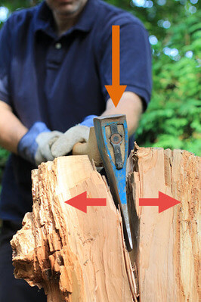
A wedge has an inclined plane on either side.
Blades like the head of an axe have this shape.
When you swing an axe into a block of wood, the wedge forces the wood apart and splits it. This is because the inclined planes generate a force that pushes outwards.

Slide 10
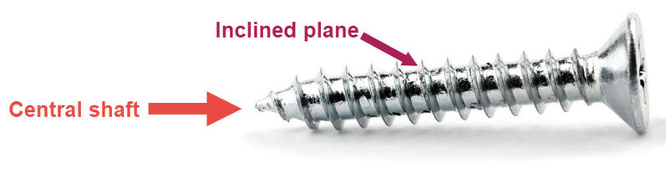
A screw is another application of an inclined plane.
In this case, the plane is wound around a central shaft. It is more complicated than a wedge and is used in different ways.

Slide 11
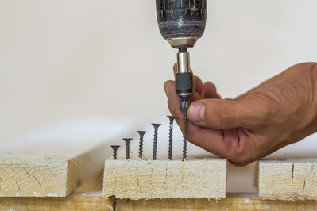
Screws are used to fasten larger objects together, such as holding pieces of wood and metal together in furniture.
With a bit of effort, you can make a screw dig into a piece of wood by rotating it. This is what screwdrivers are used for.

Slide 12
